Slide 1
Enterprise Miner Decision Tree Tips

Slide 2
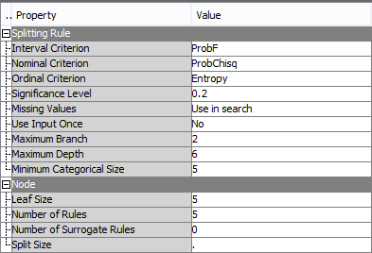
Decision Tree Node
The Decision Tree node is in the Model tab of Enterprise Miner
The major Properties Panel settings we will use are
The 3 Split Criterion fields to change splits
Maximum Branch and Maximum Depth fields, and the Leaf Size Field to limit tree size

Slide 3
Decision Tree Node – Split Criterion Fields
The 3 Split Criterion Fields correspond to the type of split the tree will use for 3 different target measurement types
Your options are listed on the next slide

Slide 4
Enterprise Miner Decision Tree Node Train Properties: Splitting Rules
Interval Criterion — specify the method that you want to use to evaluate candidate splitting rules for interval variables and to search for the best one. Choose from the following splitting criteria:
ProbF — p-value of F-test associated with node variance.
Variance — reduction in the square error from node means.
Nominal (and Binary) Criterion — specify the method that you want to use to evaluate candidate splitting rules for nominal variables and to search for the best one. Choose from the following splitting criteria:
ProbChisq — p-value of Pearson Chi-square statistic for target vs. the branch node.
Entropy — reduction in entropy measure.
Gini — reduction in Gini index.
Ordinal Criterion — specify the method that you want to use to evaluate candidate splitting rules for ordinal variables and to search for the best one. Choose from the following splitting criteria:
Entropy — reduction in entropy measure, adjusted with ordinal distances.
Gini — reduction in Gini index, adjusted with ordinal distances.

Slide 5
Splitting Rule Details
We learned about these splitting rules in class
You can try different splitting rules to get different splits
You will then evaluate the different models using the Model Comparison Node
Note: For the ProbF and ProbChiSq splitting techniques, you can change the significance level to get different splits since the F and Chi-square tests have p-values associated with them

Slide 6
Decision Tree Pruning Paramters
Use the Maximum Branch to limit the number of branches created at each split (2 = binary spliting)
Use Maximum Depth to limit the depth of the tree to prevent overfitting
Use Model Comparision Node to evaluate correct depth
Use Leaf Size to define minimum number of records in a leaf

Slide 7
Interactive Decision Tree
By clicking the … button in the Interactive Tree field in the properties panel, you can open an interactive tree building window which allows you to manually build a tree to your specifications

Slide 8
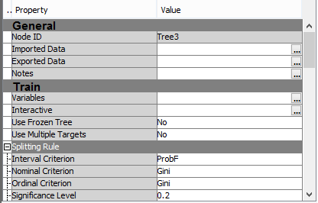
Interactive Decision Tree
Hit the … button in the Interactive field to launch the Interactive Decision Tree Window

Slide 9
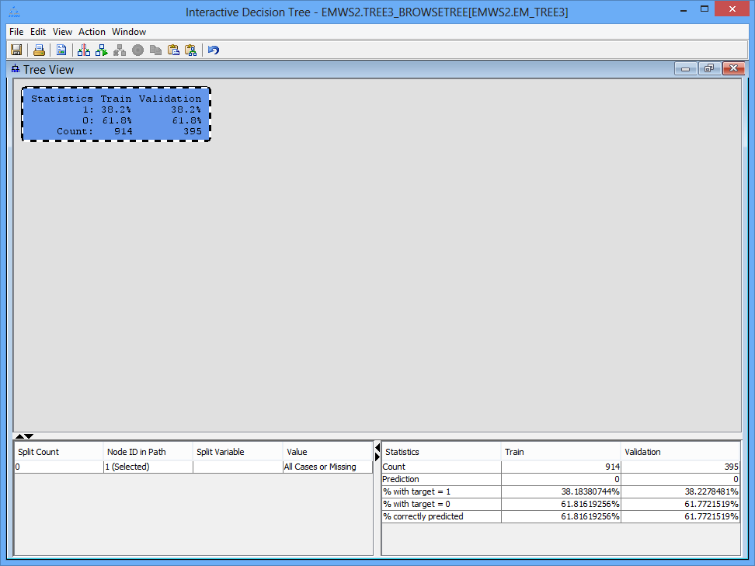
Interactive Decision Tree Window
The window to the right appears
The top node is shown with target statistics for the train and validation data sets
This node has all records

Slide 10
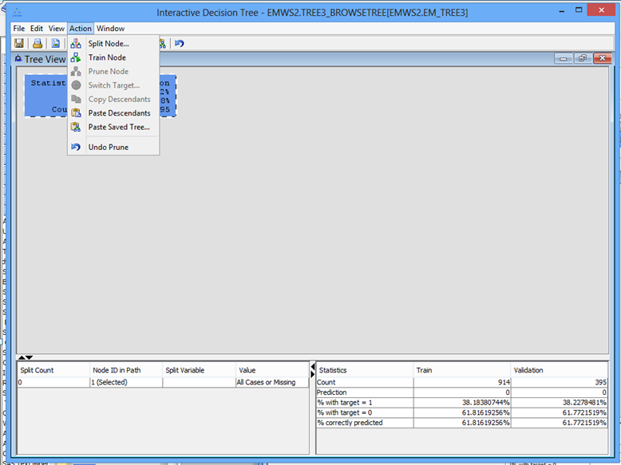
Actions in Interactive Decision Tree
Split Node
Create one split from the current node
Train Node
Complete entire tree from the current node
Prune Node
Remove all nodes below the current node

Slide 11
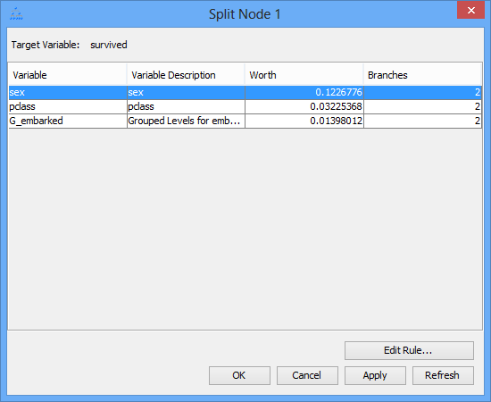
Split Node Window
When you select “Split Node”, you get a window with all possible split variables
You can select any variable
By hitting “Edit Rule…”, you can reassign categories, create separate nodes for missing values, and generally customize the split to your liking

Slide 12
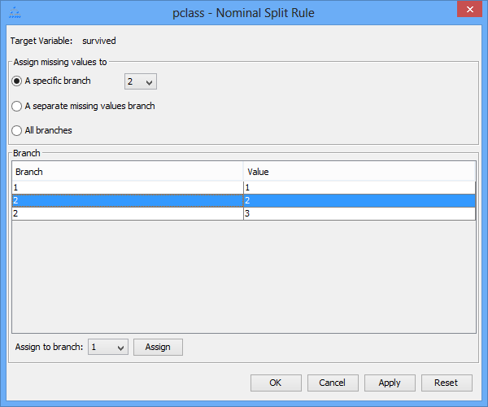
To move missing values to a specific branch, assign in the pull down at the top
For example, to assign pclass 2to the first branch with pclass 1, highlight pclass 2 and select Assign to branch 1 and hit “Assign”

Slide 13
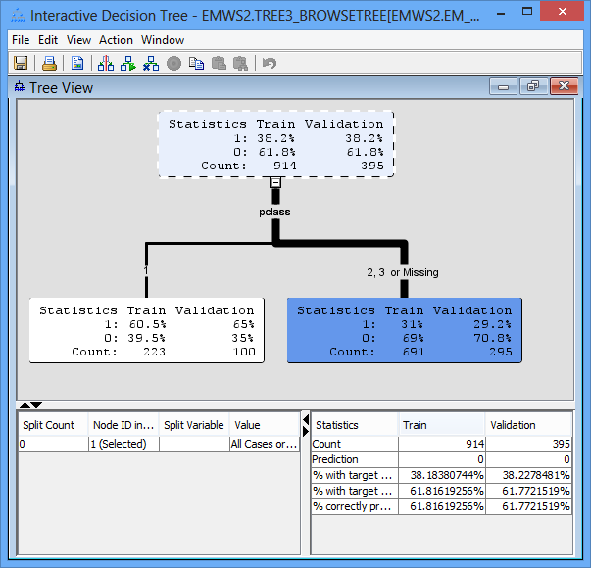
Pclass split
Here is the default split on pclass with pclass 1 in the left node and pclass 2, 3, and missing values in the right node

Slide 14
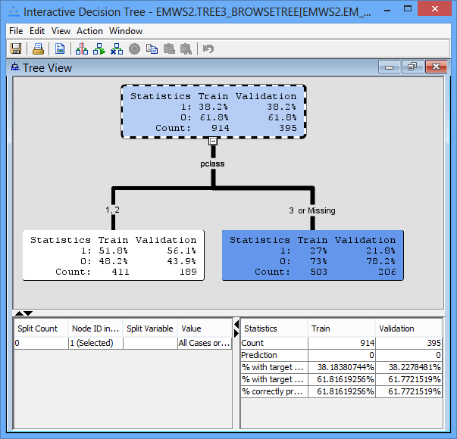
Pclass split with edit moving pclass 2 to the same node as pclass 1
Here is the split that results from assigning pclass 2 to the same node as pclass 1 using the Edit Rule button and leaving the missing values in Node 2 (This is the setting from the Edit Rule slide above)

Slide 15
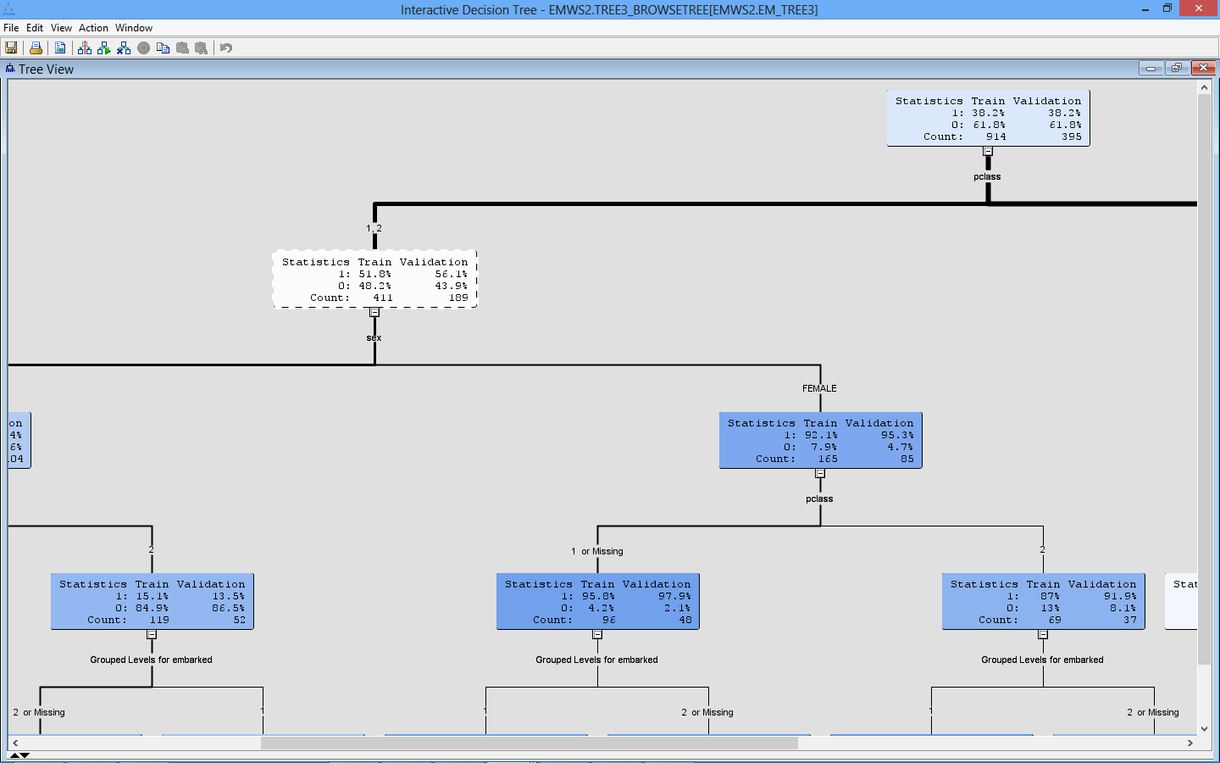
You can build an entire tree by repeatedly splitting

Slide 16
Advantages of the Interactive Decision Tree
Allow exploration of input variables and their relationship to the target in human-readable format
Also allows you to see interactions between inputs
You don’t need to drop variables as you control which variables enter the tree
Can try different variables at each split (You don’t have to take the variable with best split statistic)
This allows you to alleviate the greedy nature of decision trees
You have control over the structure of your tree
You can incorporate business head knowledge into the tree by favoring variables that you know are important
CAUTION: Be careful that you don’t bias the result to the result you want while ignoring other important variables

Slide 17
Disadvantages of Interactive Decision Trees
Time consuming
You can create a pre-conceived solution that you want
You may create a biased tree based on an agenda
No automatic pruning
You must build the tree and evaluate it with the Model Comparison Node to prevent overfitting

